Slide 1
PAPER PRESENTATION
Paper: EXPLORING LARGE LANGUAGE MODEL BASED INTELLIGENT AGENTS: DEFINITIONS, METHODS, AND PROSPECTS(https://arxiv.org/pdf/2401.03428.pdf)
Speaker: Jianbang Zhang
Mail: whdx072018@foxmail.com
Date: 2024-03-14

Slide 2
Topic A SURVEY OF Autonomous Agent
PREFACE: Introduction and Methodology
1.Definition
2.Development and History
3.Category
4.Structures
5.Training or Tuning
6.Evaluation
7.Prospect

Slide 3
PREFACE: Introduction and Methodology
Methodology
Methodology
Three Steps reading method:
STEP ONE: Read the Abstract and Conclusion: Understand the problem the author is investigating, the results or contributions made, and any limitations or future prospects mentioned by the author.
STEP TWO: Carefully Study Figures and Tables:Figures and tables represent the core design ideas of the author and relevant experimental comparisons.
STEP THREE: Review the Research Methods and Background: Finally, delve into the research methods employed and the background information provided in the paper.

Slide 4
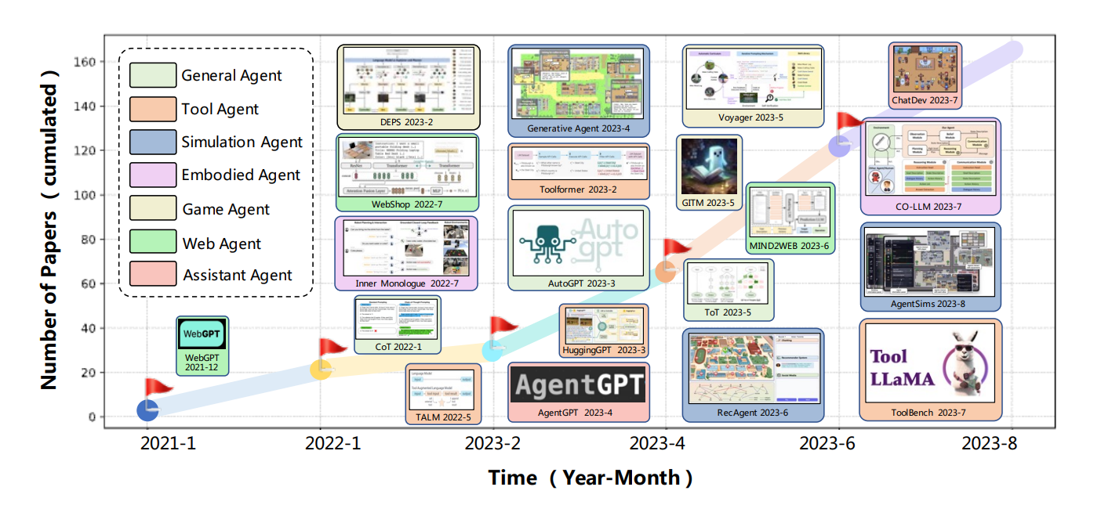
PREFACE: Introduction and Methodology
Methodology
- Critical thinking: Read the paper with questions and skepticism, make it clear how the author presents their viewpoint, and grasp the experimental methods used in the research.
- Paper positioning: It involves both horizontal and vertical comparisons. Horizontally, one examines the author's sources of inspiration and ideas. Vertically, the focus shifts to how the author's paper advances existing research. By considering the timeline and parallel axes, one can comprehensively assess the paper's positioning.
- Special Attention: Take note of the papers repeatedly mentioned by the author.
(Referred from `A Survey on Large Language Model based Autonomous Agents`)

Slide 5
1. Definition What is the autonomous Agent?
From Reinforcement Learning’s perspective:
The "agent" refers to the entity that interact with the environment dynamically.This process could be defined as `Markov Decision Process`,that is
(state,action,observation,transition,reword,state,...).
Key Premise:
Support that state,space and action space and observation space are both observable.
From LLM’s Perspective:
LLM-based agent:The interactive evaluation of LLM-as-Agent could be regarded as a Partially Observable Markov Decision Process (S, A, T , R, U, O), which comprises state space S, action space A, transition function T : S × A → S, reward assigning function R, task instruction space U, and observation space O.
(Referred from `AGENTBENCH: EVALUATING LLMS AS AGENTS`)

Slide 6
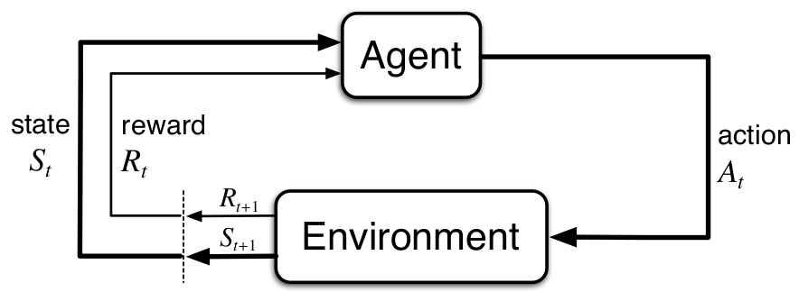
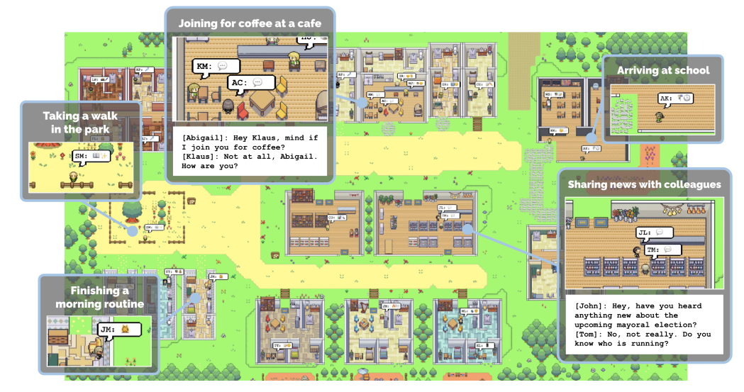
1. Definition What is the autonomous Agent?
(referred from `Generative Agents: Interactive Simulacra of Human Behavior`)

Slide 7
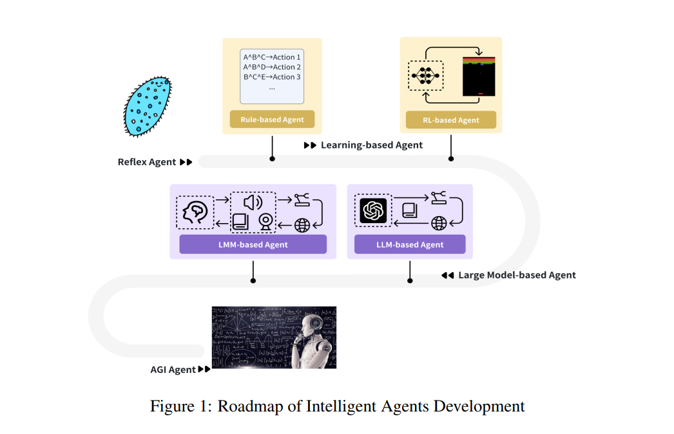
2.Development and History

Slide 8
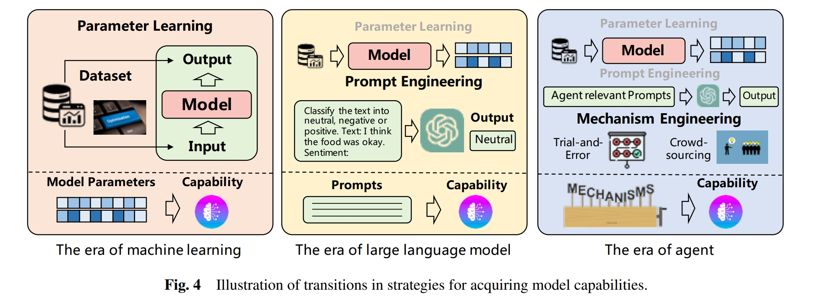
2.Development and History
(Referred from `A Survey on Large Language Model based Autonomous Agents`)

Slide 9
3.Category
Different VIEWS
VIEWS | CATEGORIED | REFERRED PAPER
SYSTEM MECHANISM | Single-Agent System Tool Environment Multi-Agent System Relation: Cooperative, Competitive, Mixed, Hierarchical Plan and Exec: CPDE DPDE | EXPLORING LARGE LANGUAGE MODEL BASED INTELLIGENT AGENTS: DEFINITIONS, METHODS, AND PROSPECTS
TOOL CATEGORY | Physical Interaction-based Tool GUI-based Tools Program-based Tools | Tool Learning with Foundation Models

Slide 10
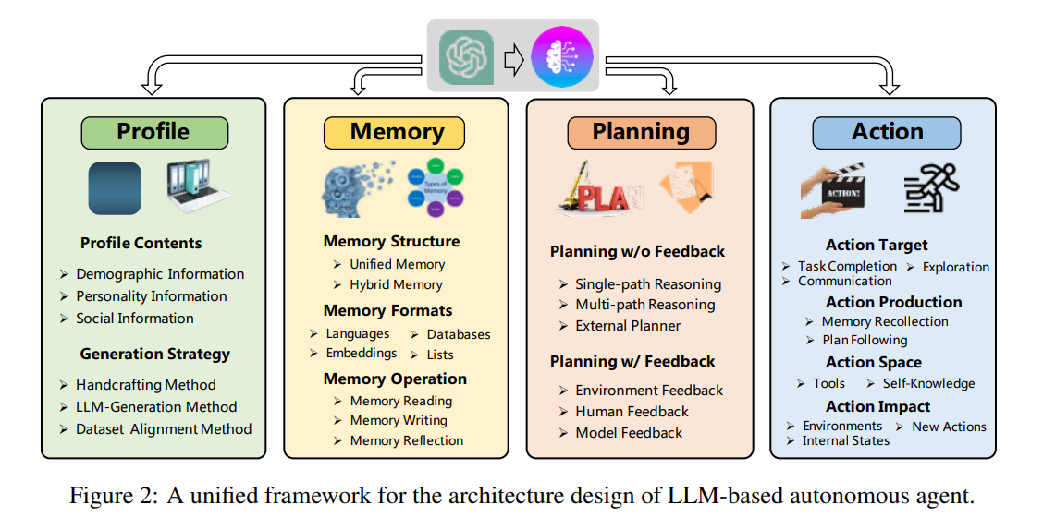
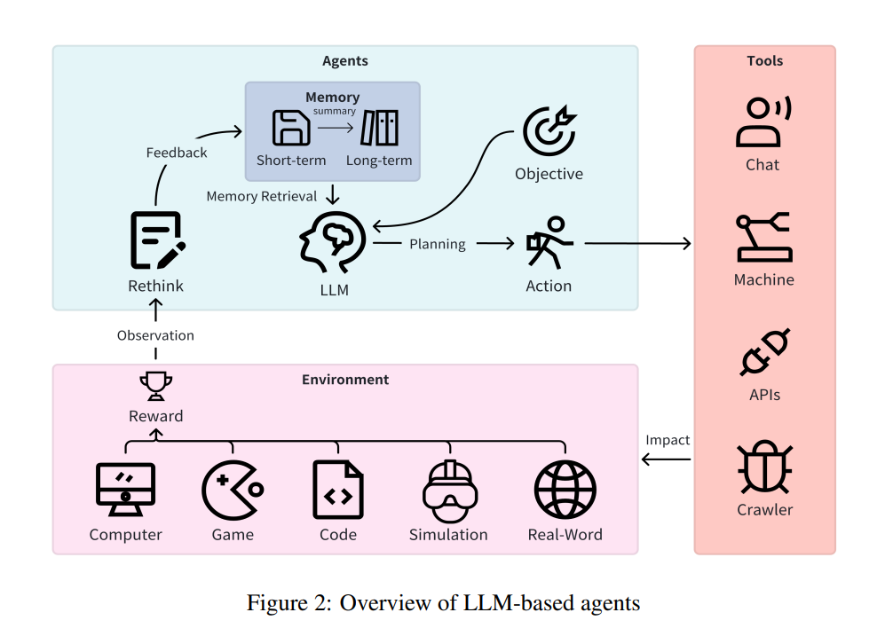
4.Structures OVERVIEW:
(Referred from `A Survey on Large Language Model based Autonomous Agents`)

Slide 11

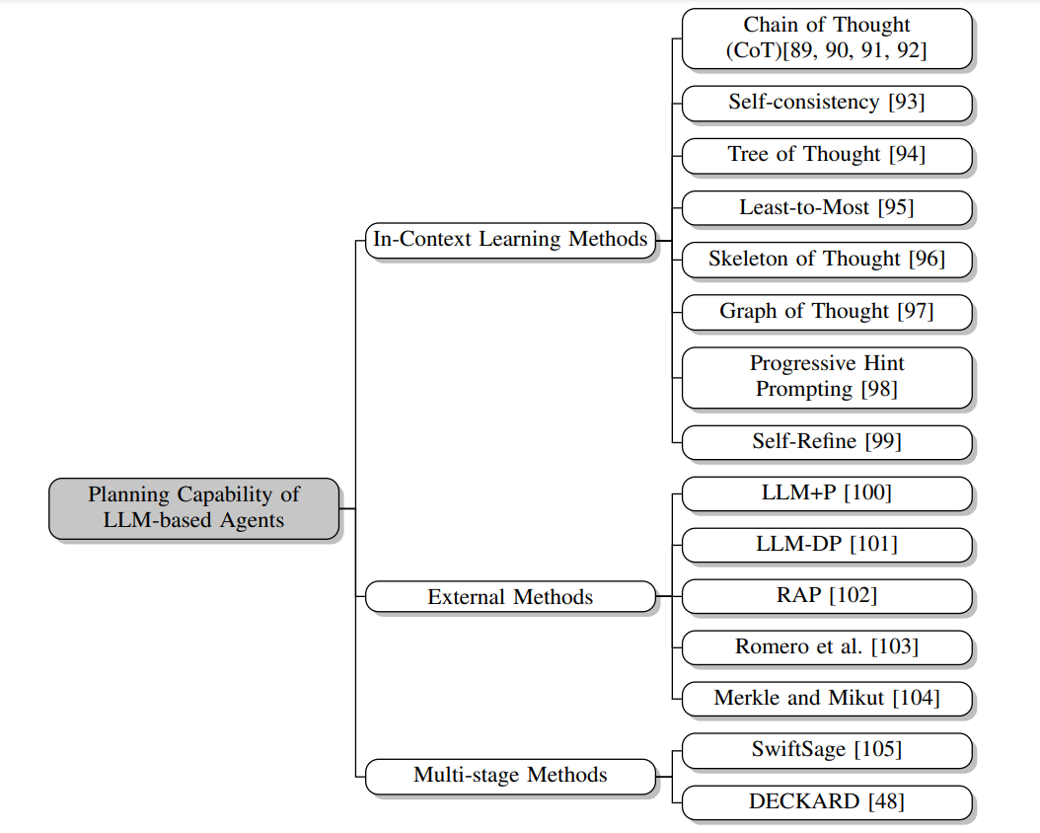
4-1 PLAN
PLAN:a scheme or method of acting, doing, proceeding, making, etc., developed in advance: battle plans. a design or scheme of arrangement: an elaborate plan for seating guests.
It’s a vital feature of LLM-based agents, encompassing task analysis, potential action anticipation, optimal action selection, and the ability to tackle complex problems and tasks.

Slide 12
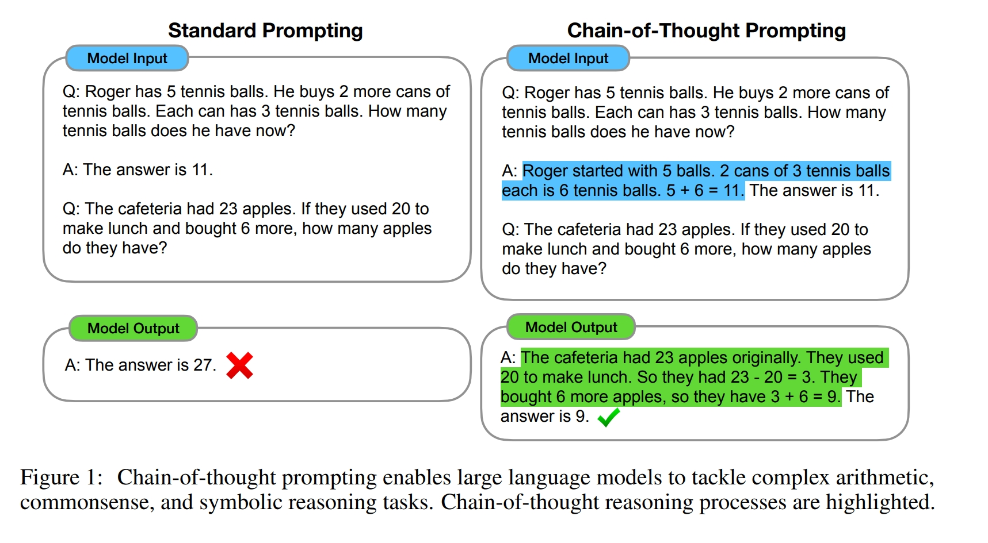
4-1 PLAN CHAIN OF THOUGHT/SELF-CONSISTANCY
(Referred from `Chain-of-Thought Prompting Elicits Reasoning in Large Language Models`)

Slide 13
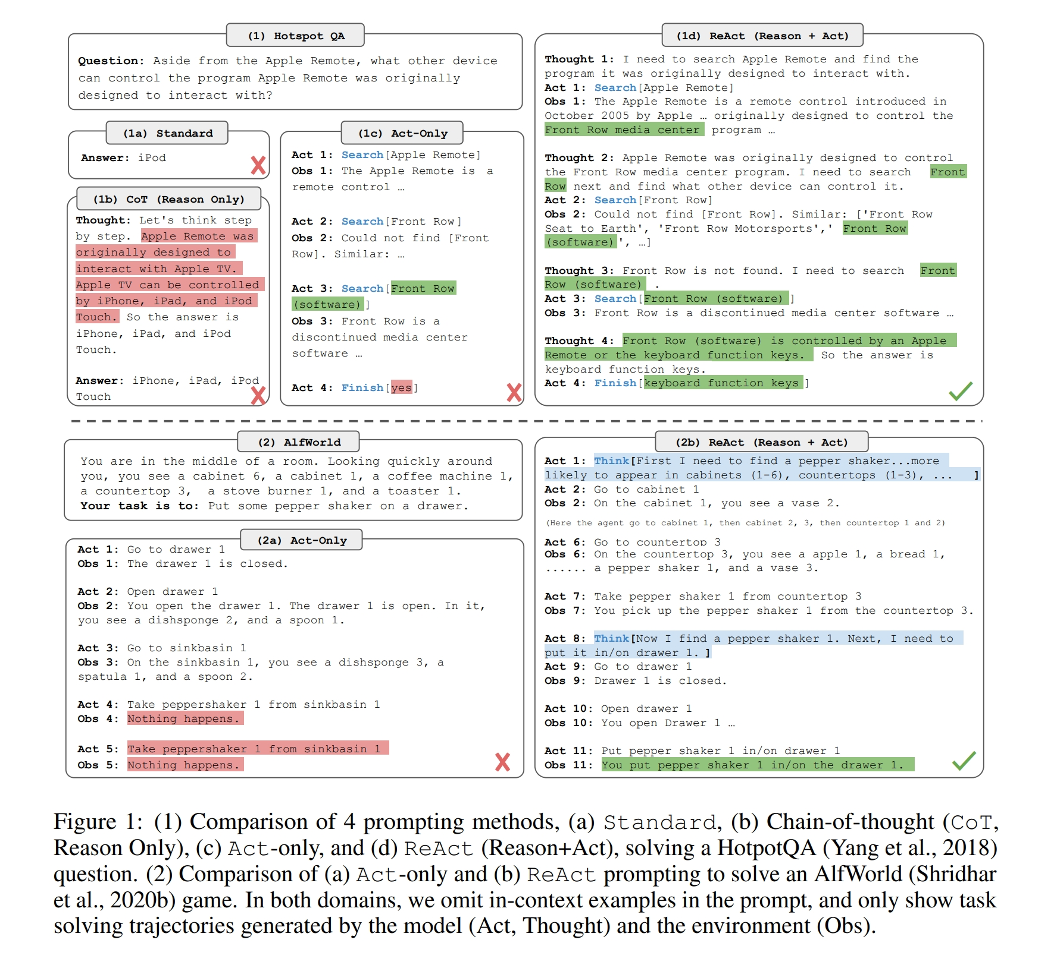
4-1 PLAN ReAct
(Referred from `REAC T: SYNERGIZING REASONING AND ACTING IN LANGUAGE MODELS`)

Slide 14
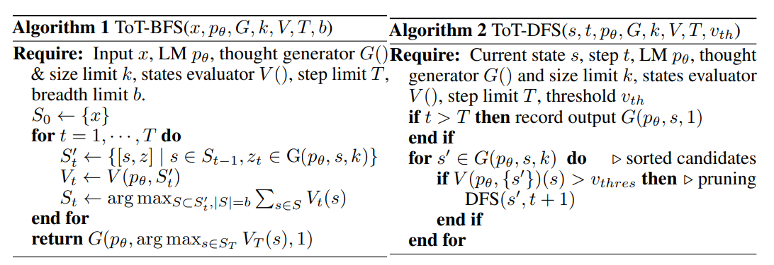
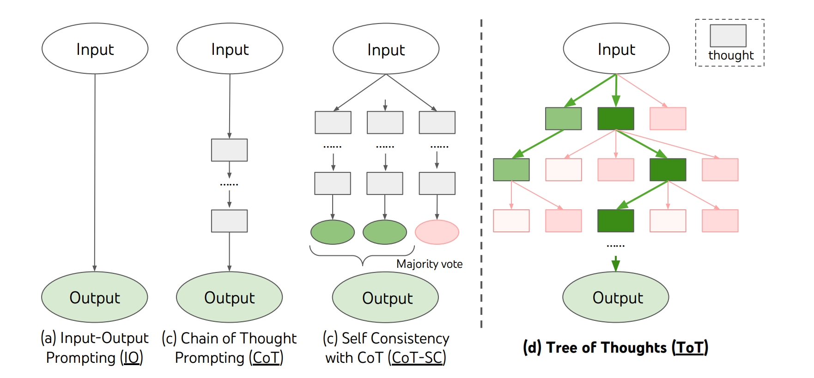
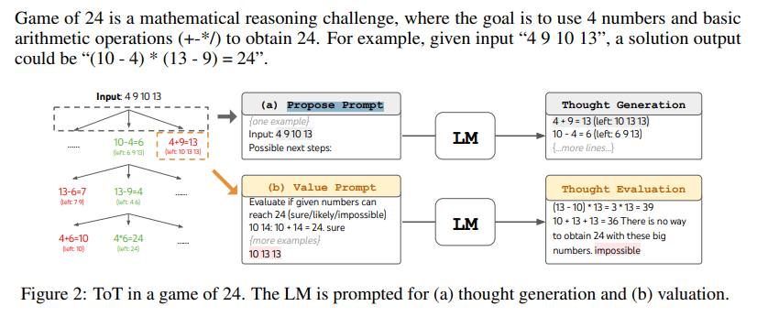
4-1 PLAN TOT
(Referred from `Tree of Thoughts: Deliberate Problem Solving with Large Language Models`)

Slide 15
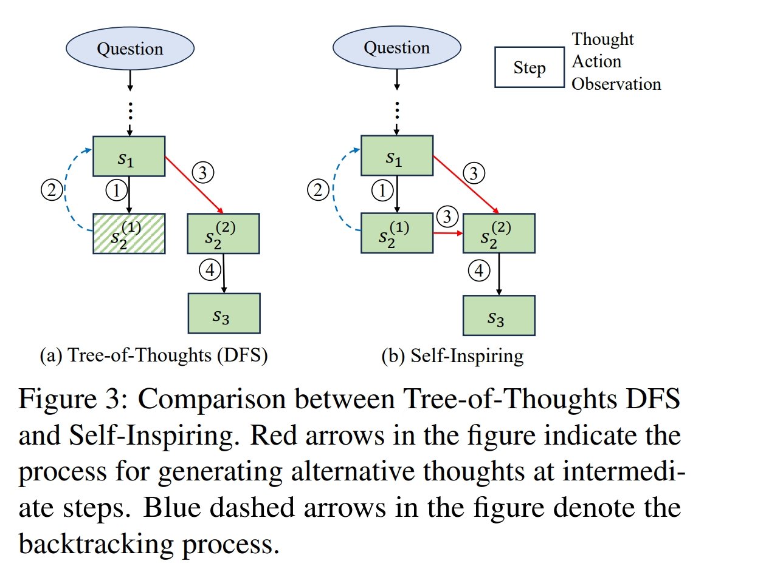
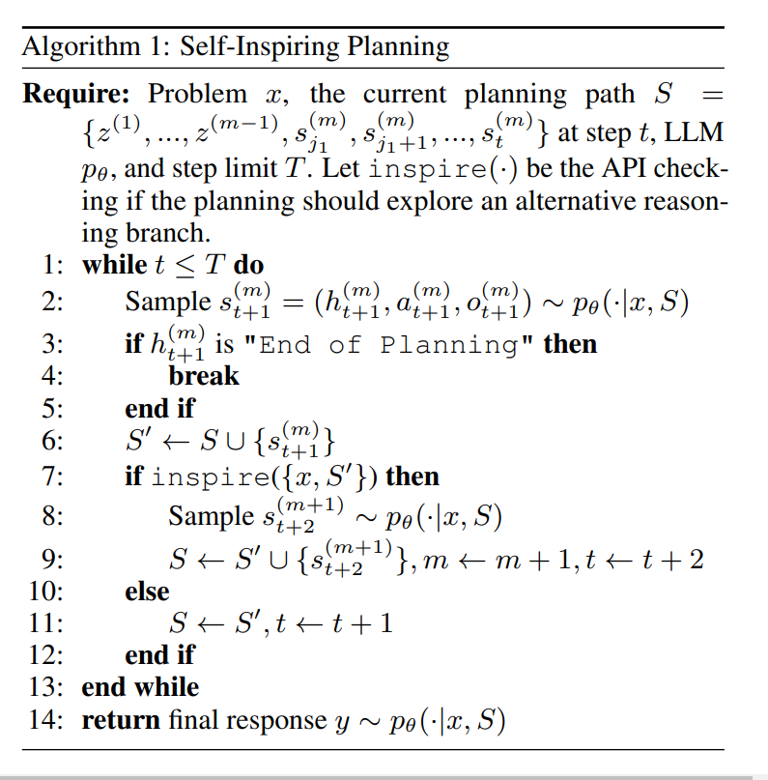
4-1 PLAN RecMind
(Referred from `RecMind: Large Language Model Powered Agent For Recommendation`)

Slide 16
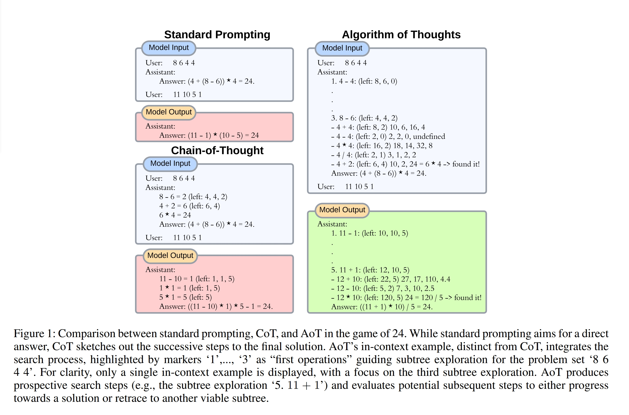
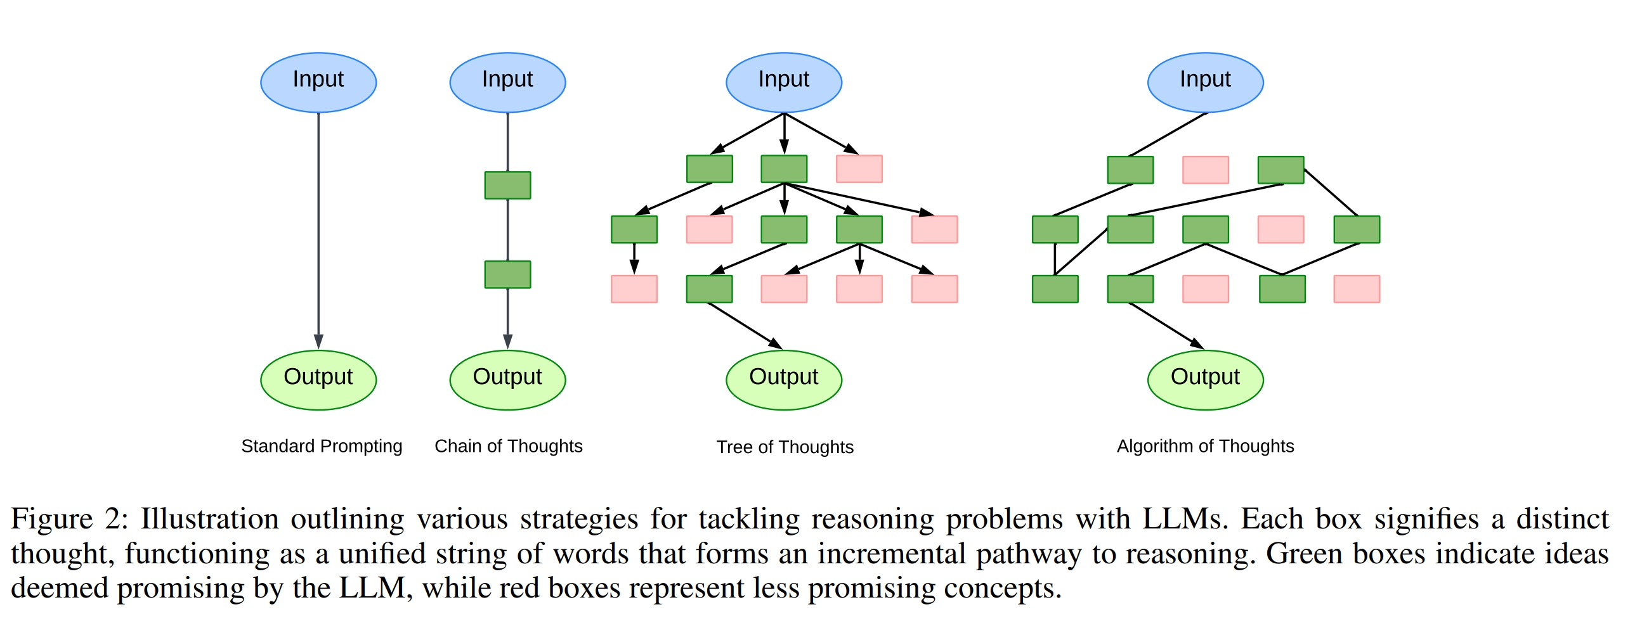
4-1 PLAN AOT
(Referred from `Algorithm of Thoughts: Enhancing Exploration of Ideas in Large Language Models`)

Slide 17
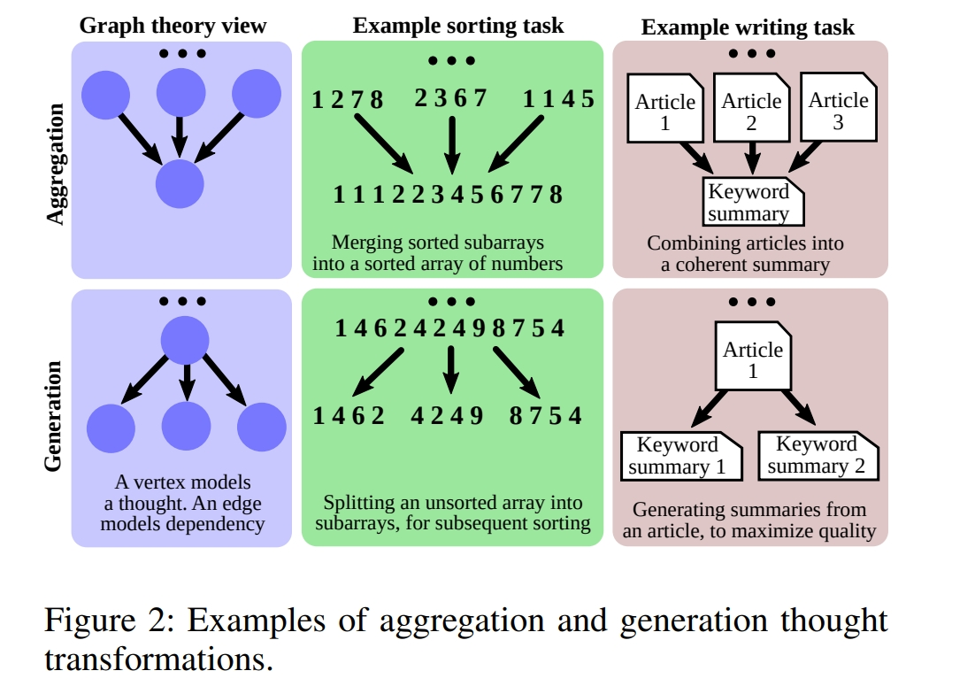
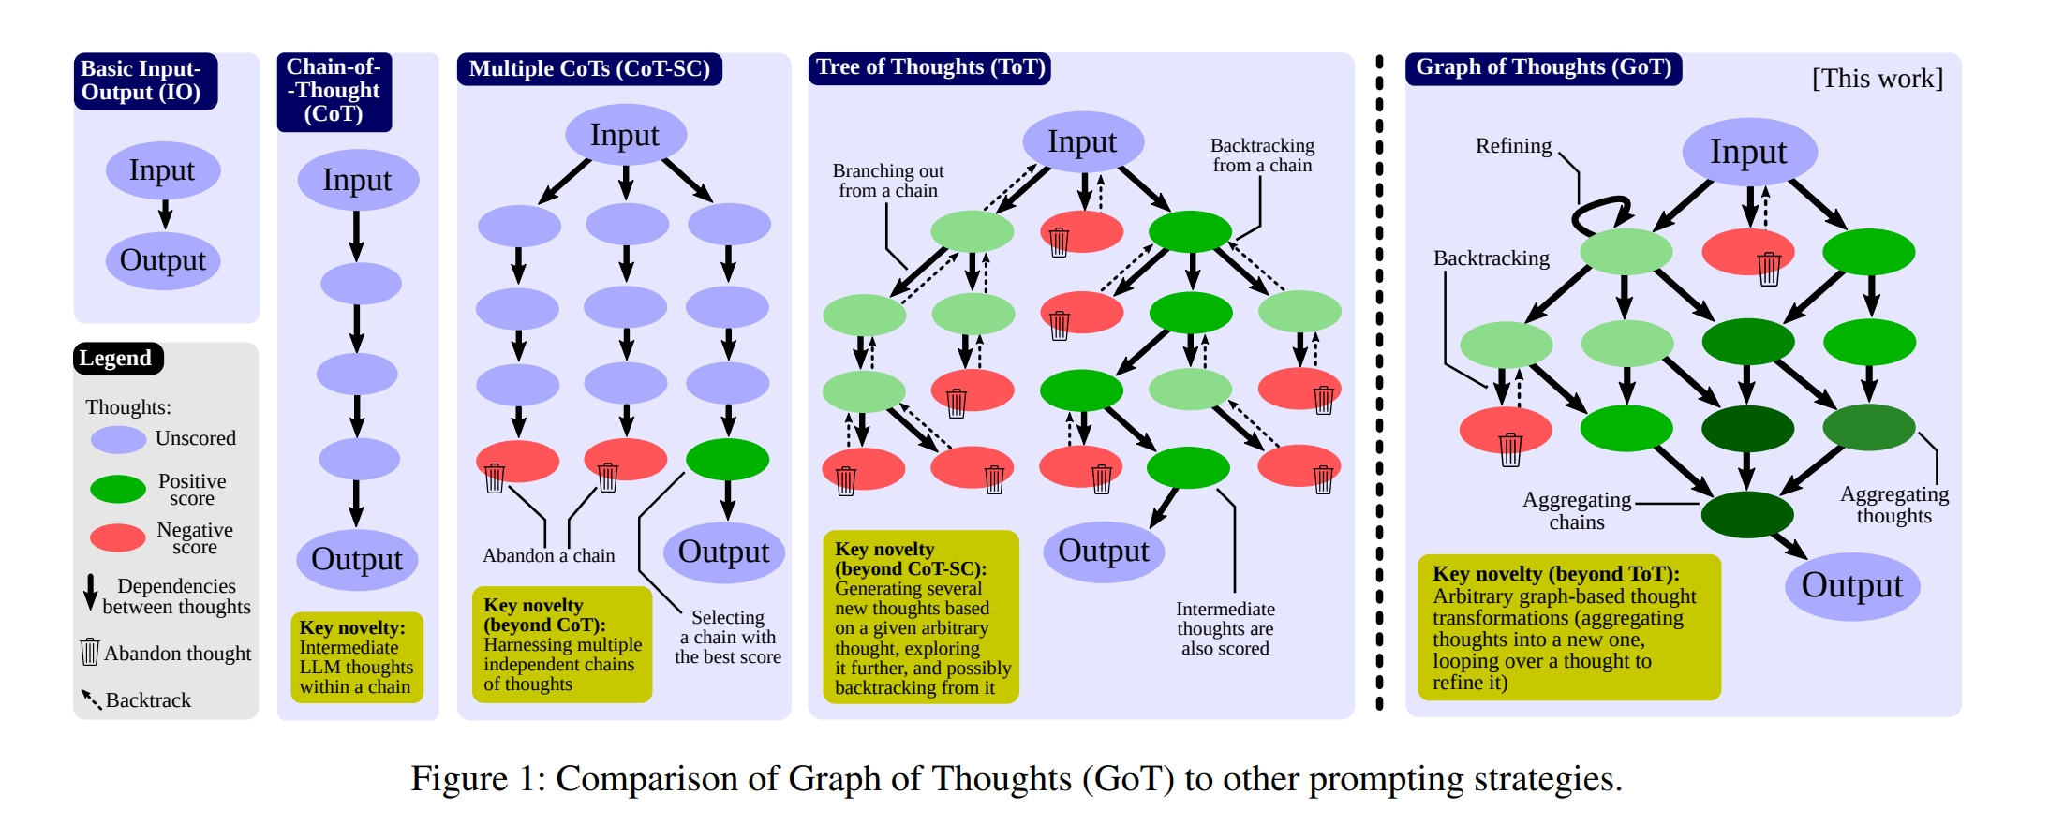
4-1 PLAN GOT
(Referred from `Graph of Thoughts: Solving Elaborate Problems with Large Language Models`)

Slide 18
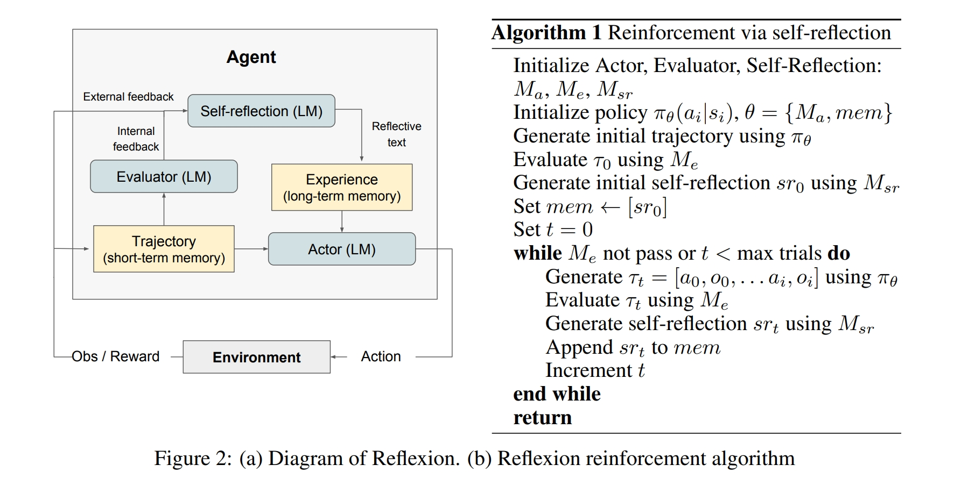
4-2 Memory SHORT OR LONG?
(Referred from `Reflexion: Language Agents with Verbal Reinforcement Learning`)

Slide 19
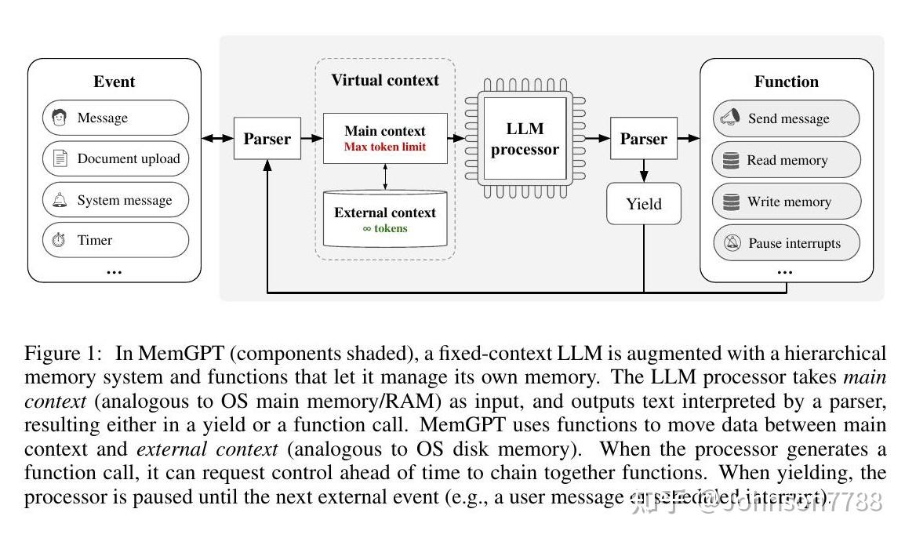
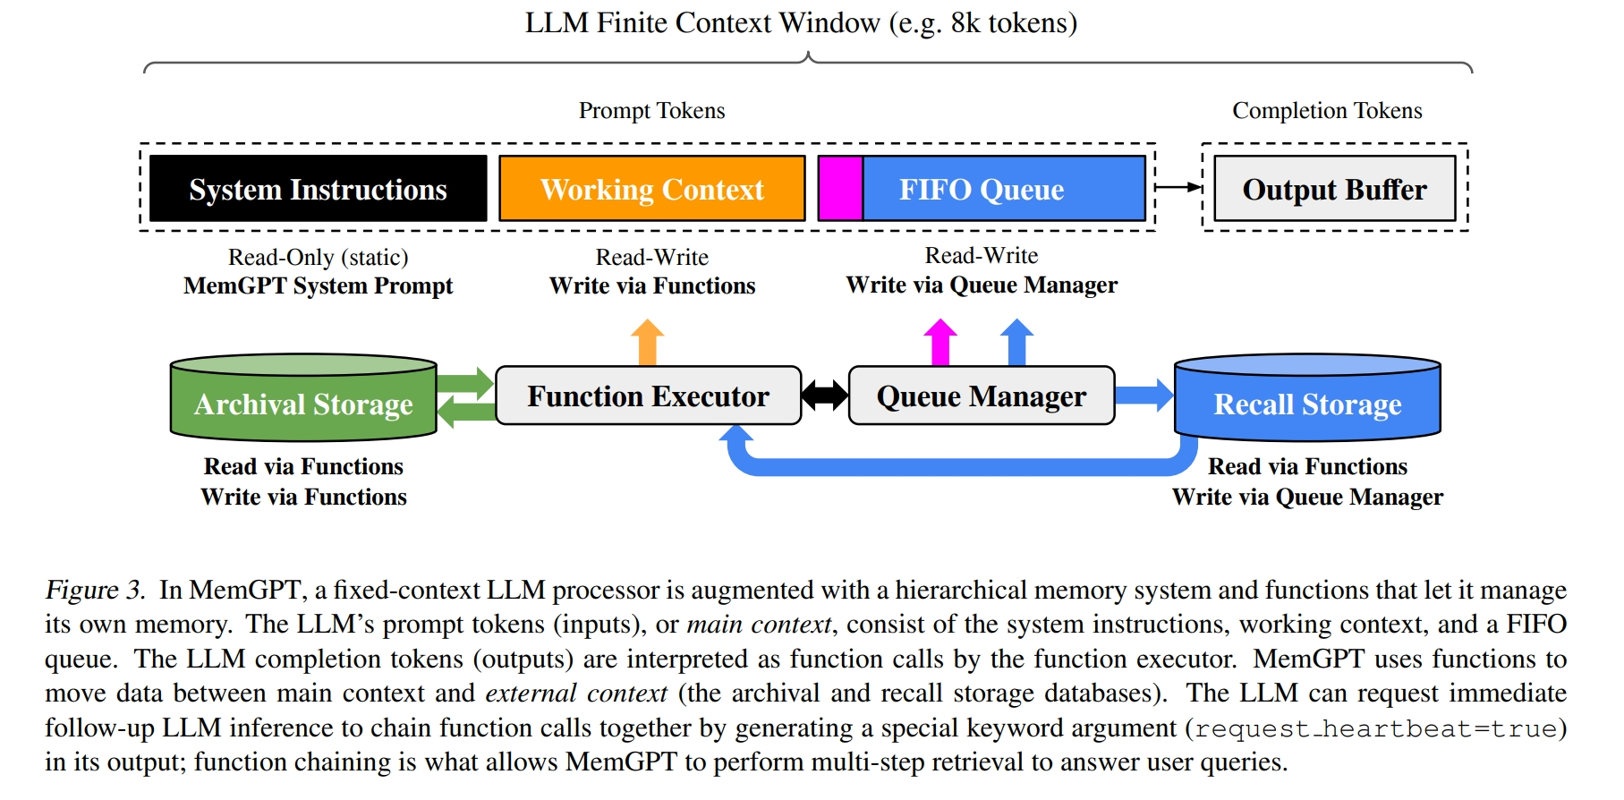
4-2 Memory MemGPT
MemGPT and its Memory Hierarchies
(Referred from `MemGPT: Towards LLMs as Operating Systems`)

Slide 20
4-2 Memory Aspects of Memory
Memory write: reflexion,repeats,and rethink
Memory Retrieval:recency,relevance,and importance
Memory Overflow: first in first out
Memory Depulicate: abstract or filter out
Resource of Memory:
Paper: Understanding ACT-R an Outsider’s Perspective
Book: The Oxford Handbook of Cognitive Science

Slide 21
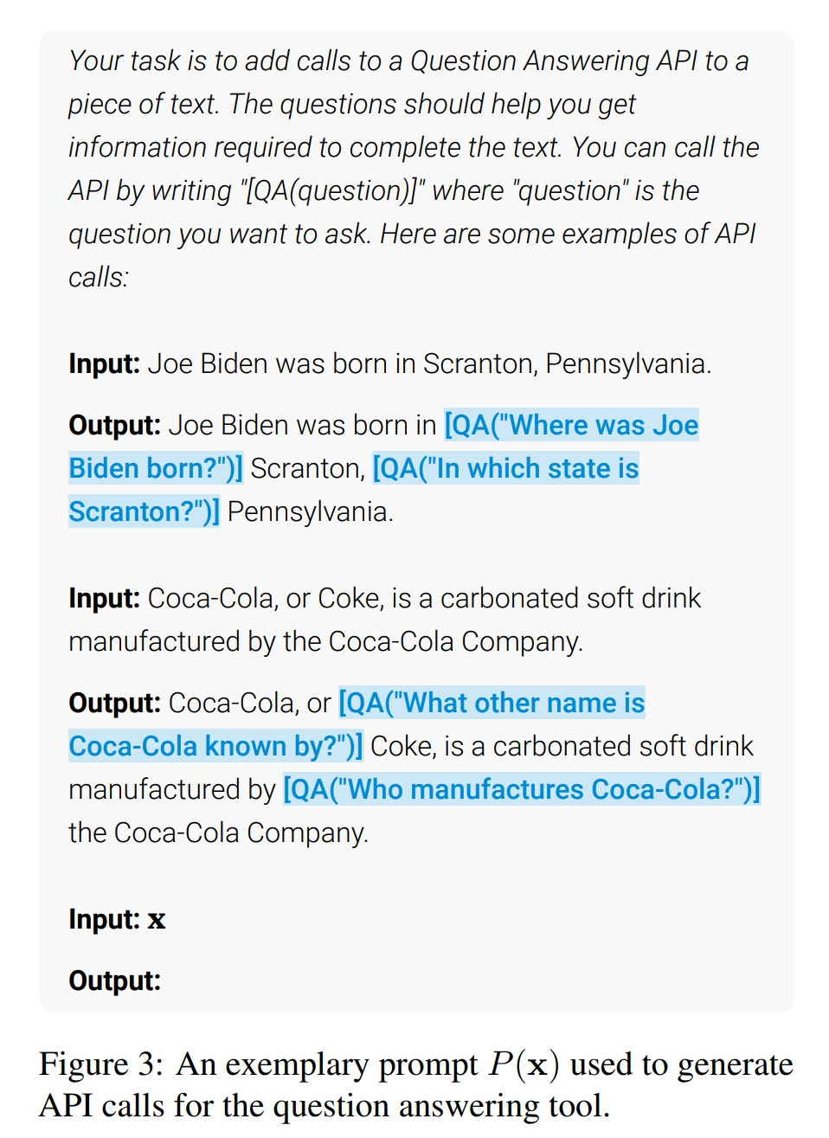
4-3 Action 2W1H
(Referred from `Toolformer: Language Models Can Teach Themselves to Use Tools`)
When to act
LLM-based agent should know when
to call tools.
What to act
LLM-based agent should make it
clear that which tools need to
call.
How to act
LLM-based agent should how to decompose difficult tasks into sub- tasks and how to plan the execution sequence of sub-tasks.

Slide 22
4-3 Action Aspacts of Action
Action Production
Action via Memory Recollection.The action is generated by extracting information from the agent memory according to the current task. The task and the extracted memories are used as prompts to trigger the agent actions.
( Paper:Generative Agents)
Action via Plan Following.
Action Space:The space of tool callable.
APIs
Databases & Knowledge Bases
External Models:Other LLMs or Models
Internal Knowledge

Slide 23
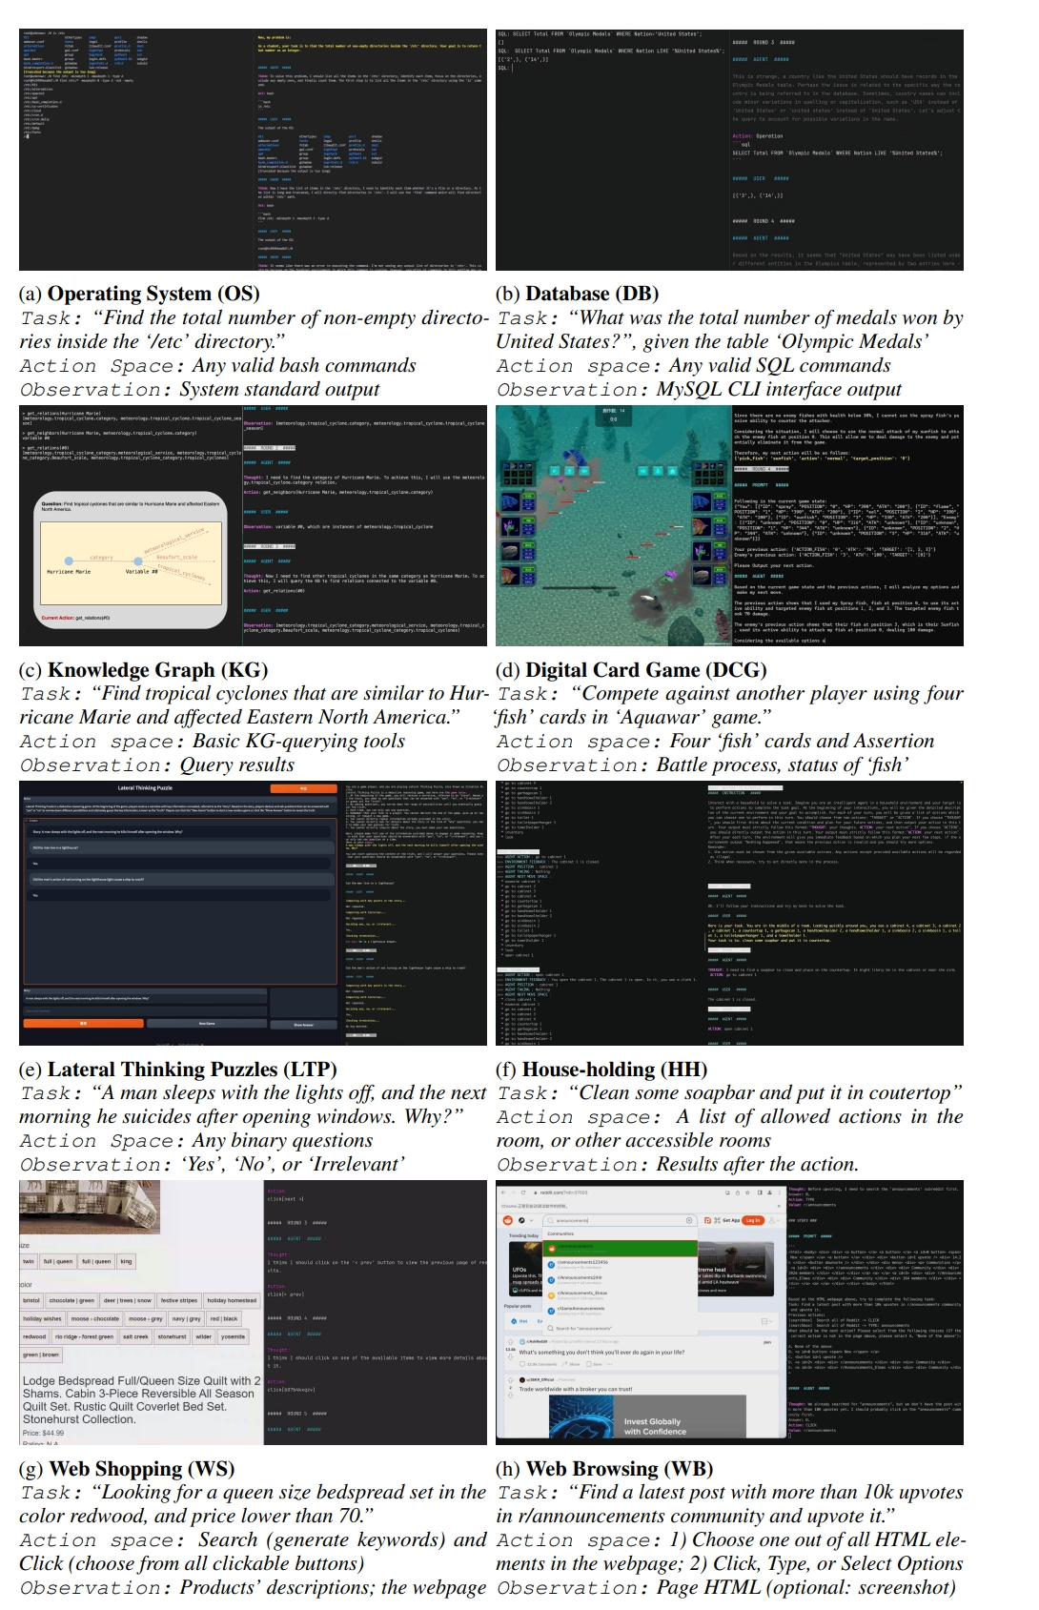
4-4 Environment
(1)Opterating System
(2)Simulation
Driving
3D Reconstruction/3D Points
Shopping
Household
Web browsing
...
(3)DataBase
(4)Human FeedBack
(Referred from `AGENTBENCH: EVALUATING LLMS AS AGENTS`)

Slide 24
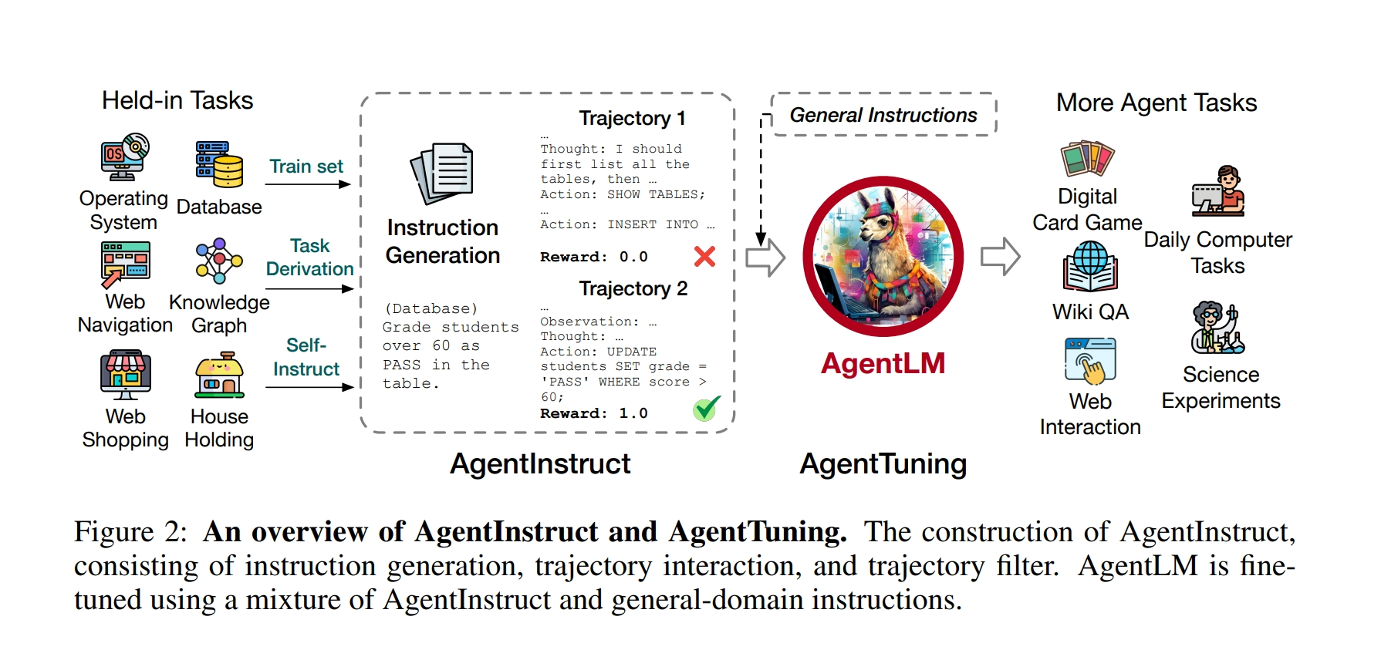
5.Training or Tuning Prompt VS Tuning
Generative Tuning
(Referred from `AGENTTUNING: ENABLING GENERALIZED AGENT ABILITIES FOR LLMS`)

Slide 25
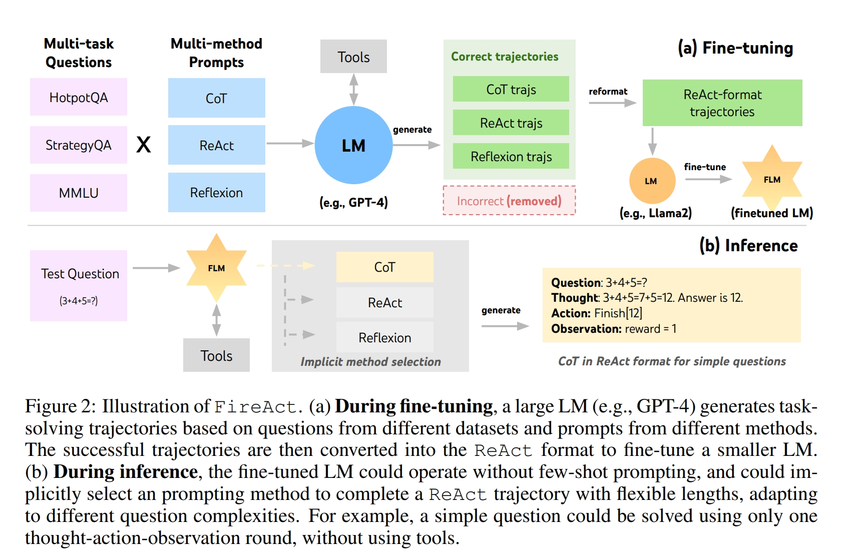
5.Training or Tuning Prompt VS Tuning
Prompt for closed-source LLLM-based Agent(Verbal reinforcement learning)
(Referred from `FIREACT:TOWARD LANGUAGE AGENT FINE-TUNING`)

Slide 26

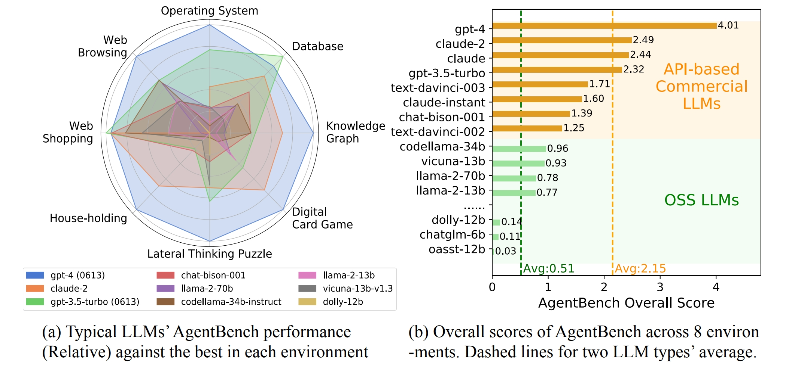
6.Evaluation
(Referred from `AGENTBENCH: EVALUATING LLMS AS AGENTS`)

Slide 27
6.Evaluation Aspacts of Evaluation
Different Sources of Feedbacks
From Expriment:Turing Test
From Labeled Datasets:EvalDatasets/MMLU
From Simulation:Such as paper `Agent bench`
From human OR Chatgpt4/Claude3
Method:
Reinforcement learning
Student-Teacher Mode
Multi-Agent vote
Multi-Agent conversations

Slide 28
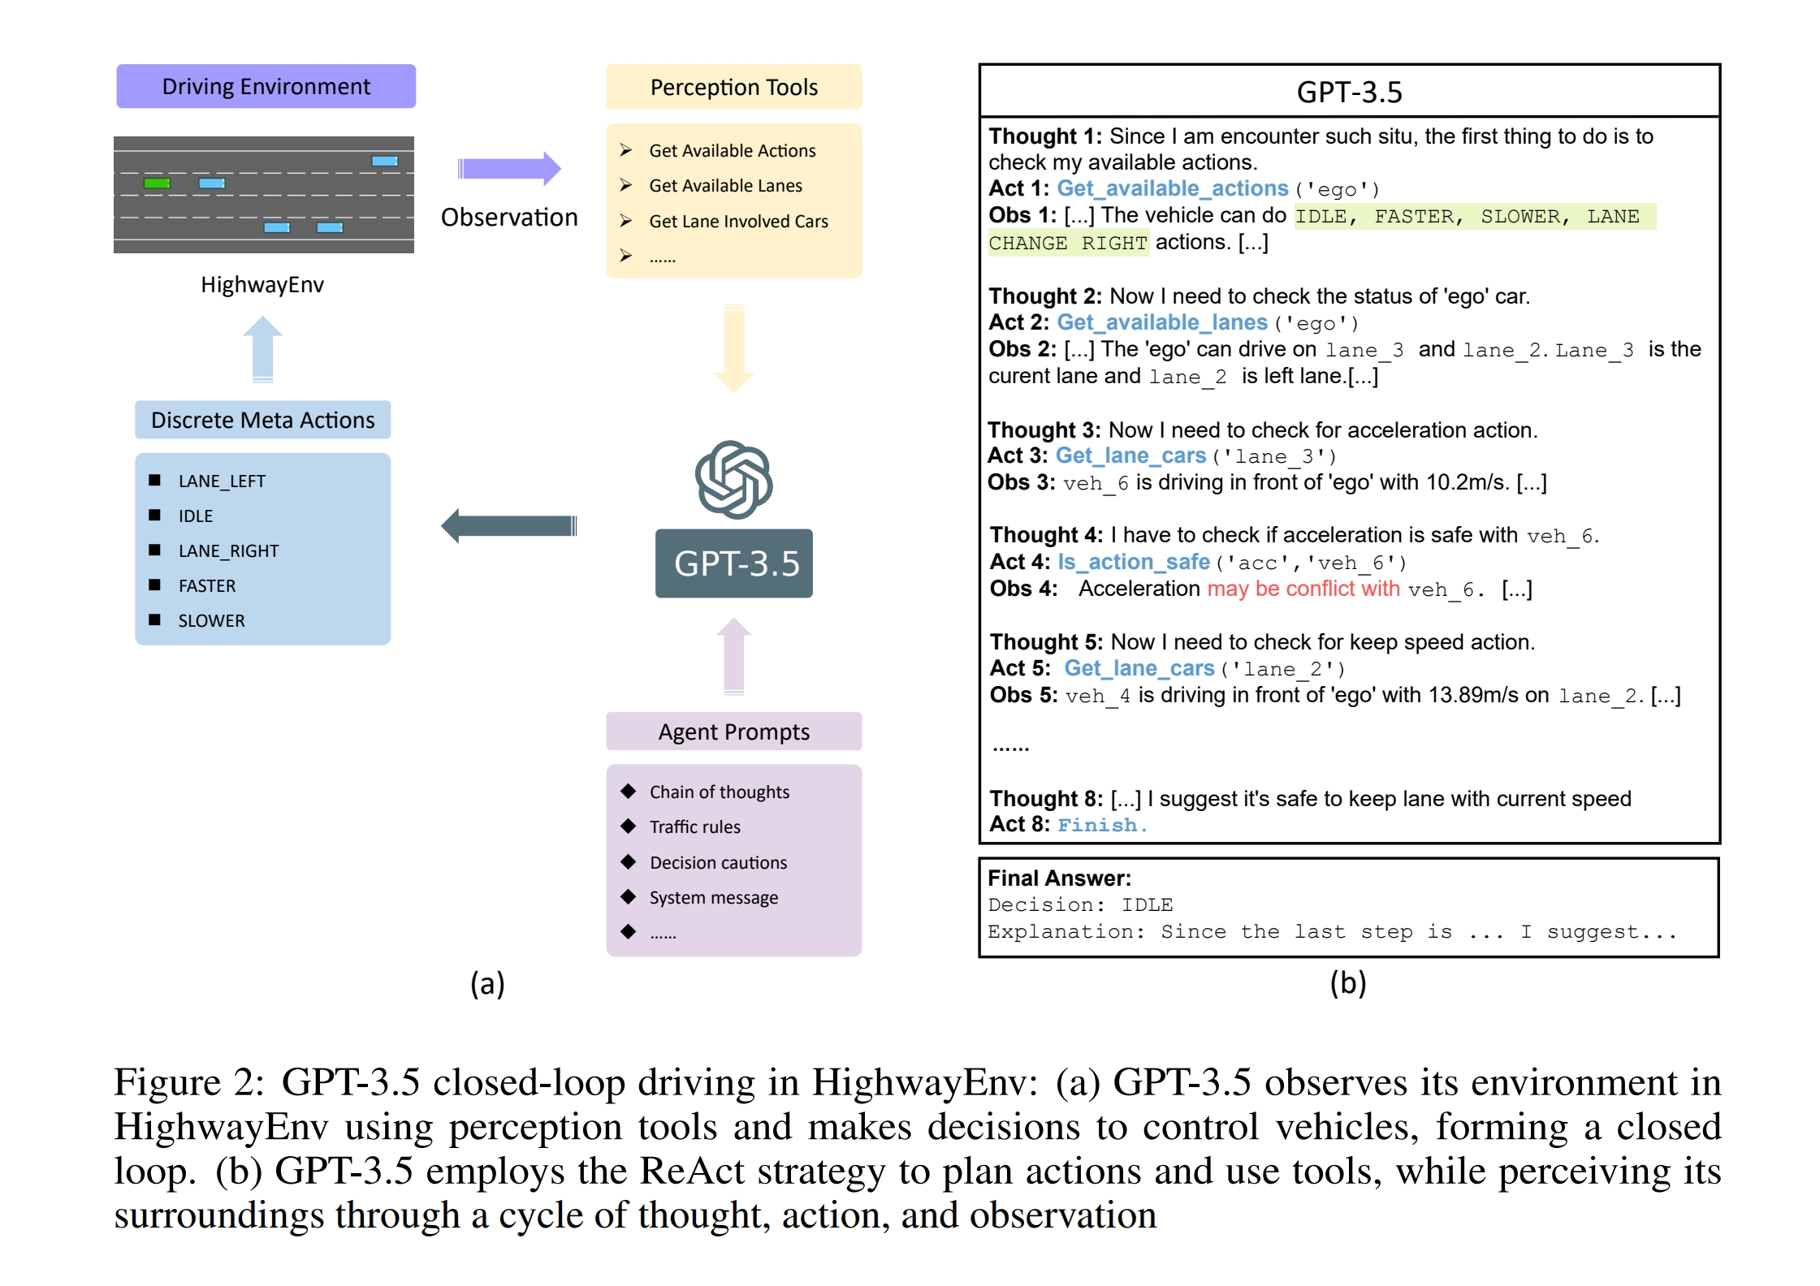
7.Prospect Applications of Autonomous Agent
1.Drive Car
(Referred from `Drive Like a Human: Rethinking Autonomous Driving with Large Language Models`)

Slide 29
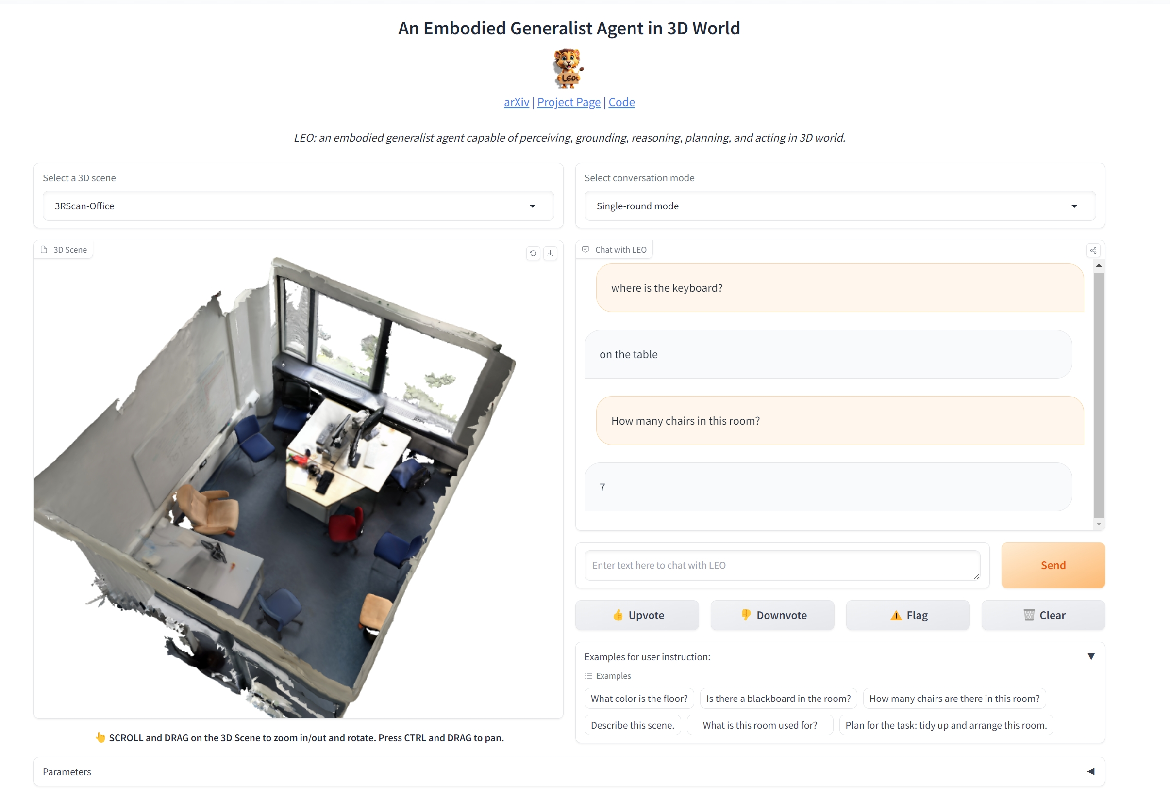
7.Prospect Applications of Autonomous Agent
2.Embodied Game
(Referred from `AN EMBODIED GENERALIST AGENT IN 3D WORLD`)

Slide 30
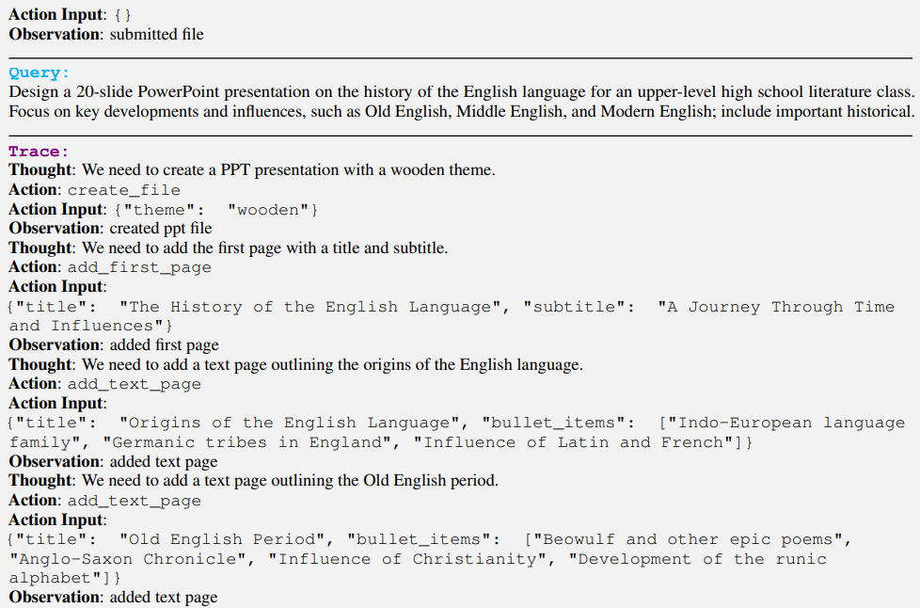
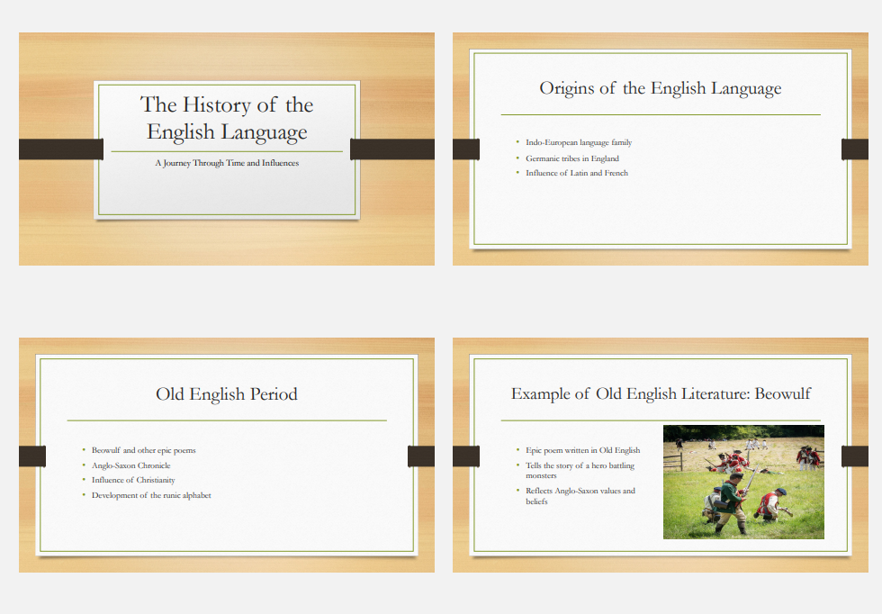
7.Prospect Applications of Autonomous Agent
3.Create PPT
(Referred from `Tool Learning with Foundation Models`)

Slide 31
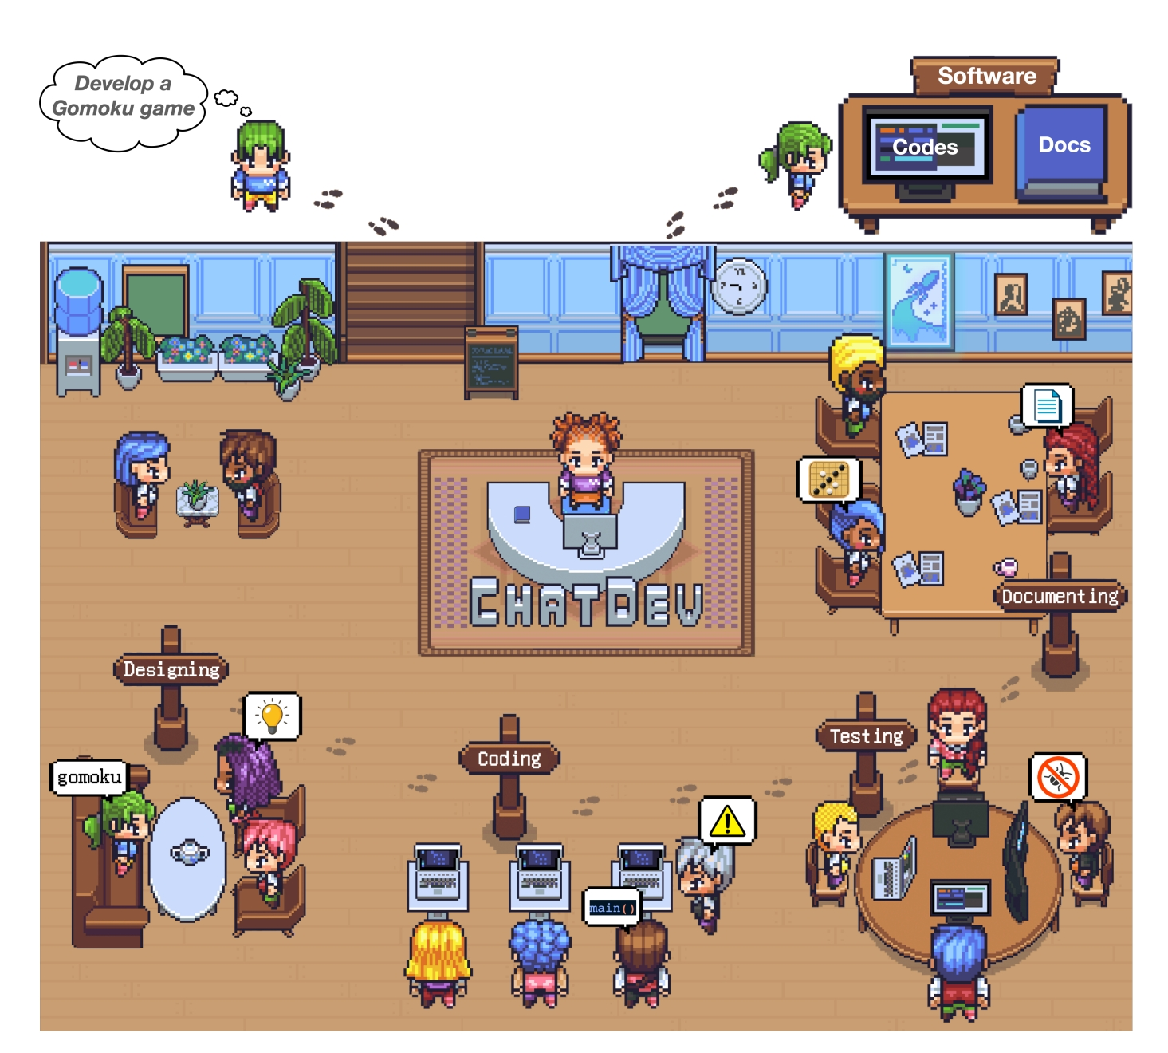
7.Prospect Applications of Autonomous Agent
4.Coding
Multiple agents develop software together through cooperation, communication, and feedback.
(Referred from `Communicative Agents for Software Development`)

Slide 32
THANKS FOR YOUR ATTENTION
Wish my sharing could serve as a catalyst for further discussion and inspiration!
Thank you!

